Slide 1

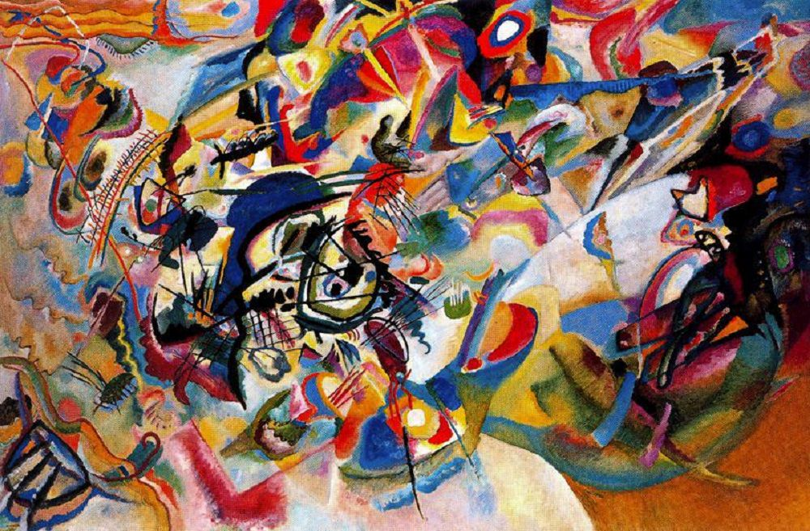
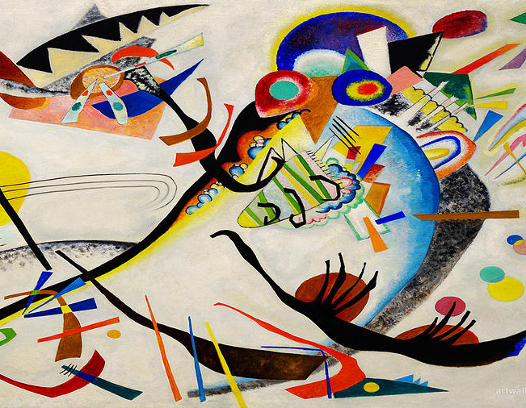
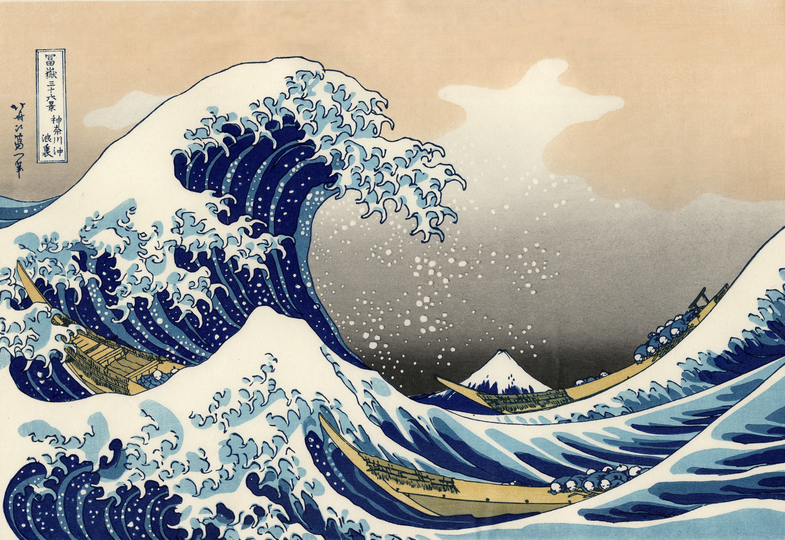
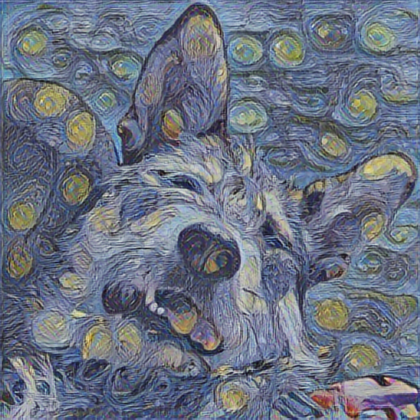
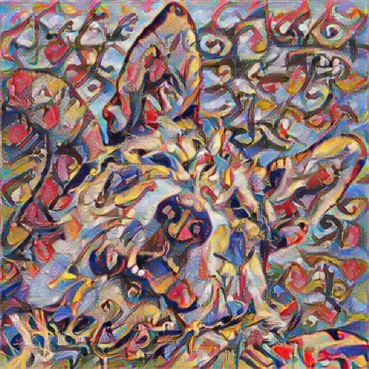
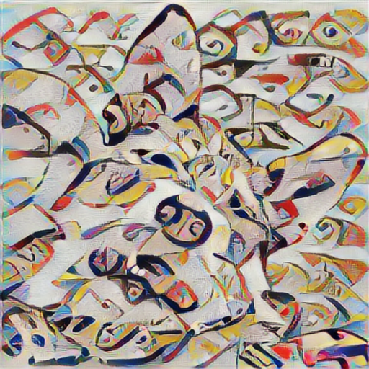
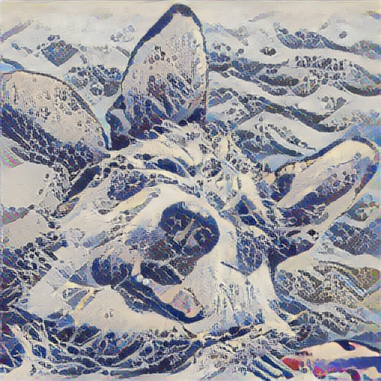
Style transfer

Slide 2

Convolutional Neural Network

Slide 3
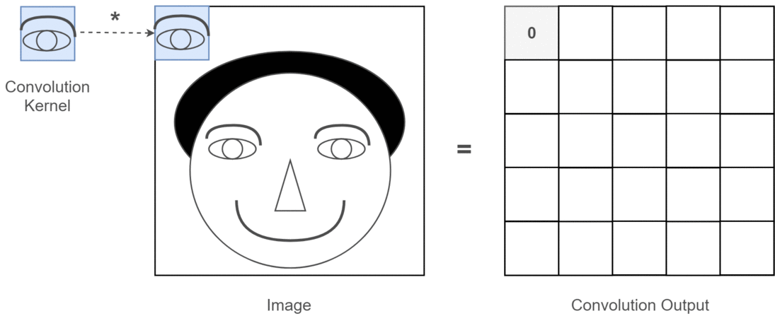
Convolutional Neural Network
CNN layer - collection of filters → extracts features
CNN layer output is activation/feature map – filtered image
Hierarchical structure of CNN layers → deeper layers capture the content of the image
It is also possible to retrieve texture, color, etc. - style content from activation maps

Slide 4
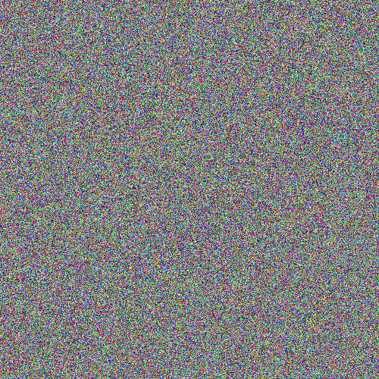
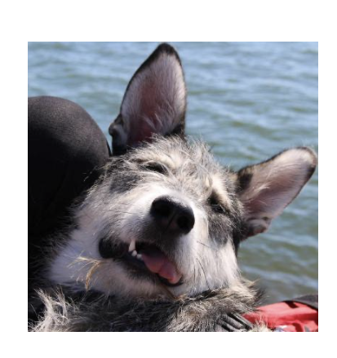
Image Reconstruction

Slide 5
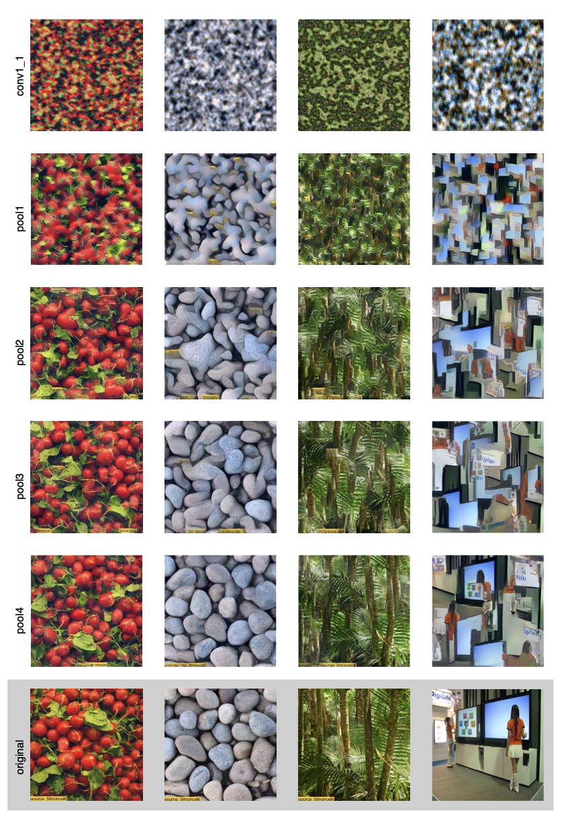
Style (texture,color) Reconstruction

Slide 6
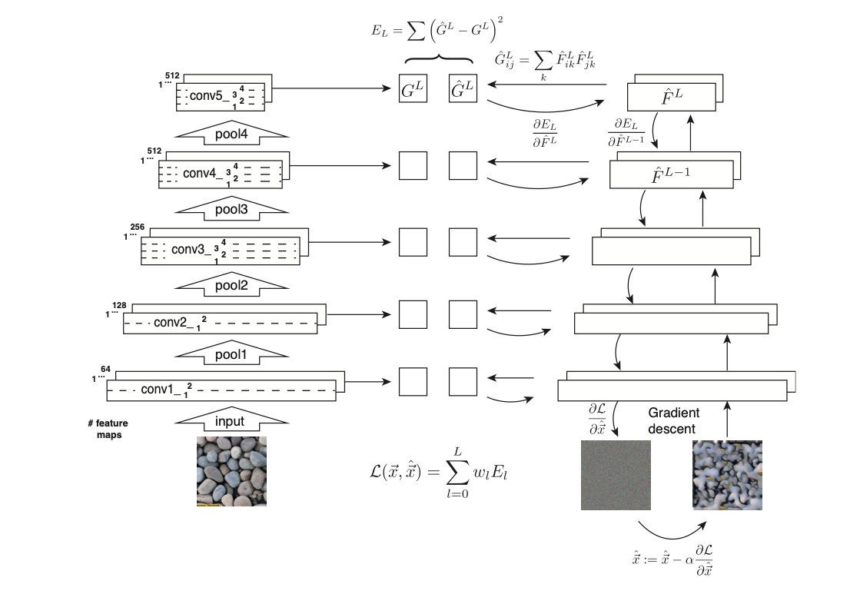
Texture Synthesis Using Convolutional Neural Networks, Gatys et al. 2015

Slide 7
Style reconstruction

Slide 8
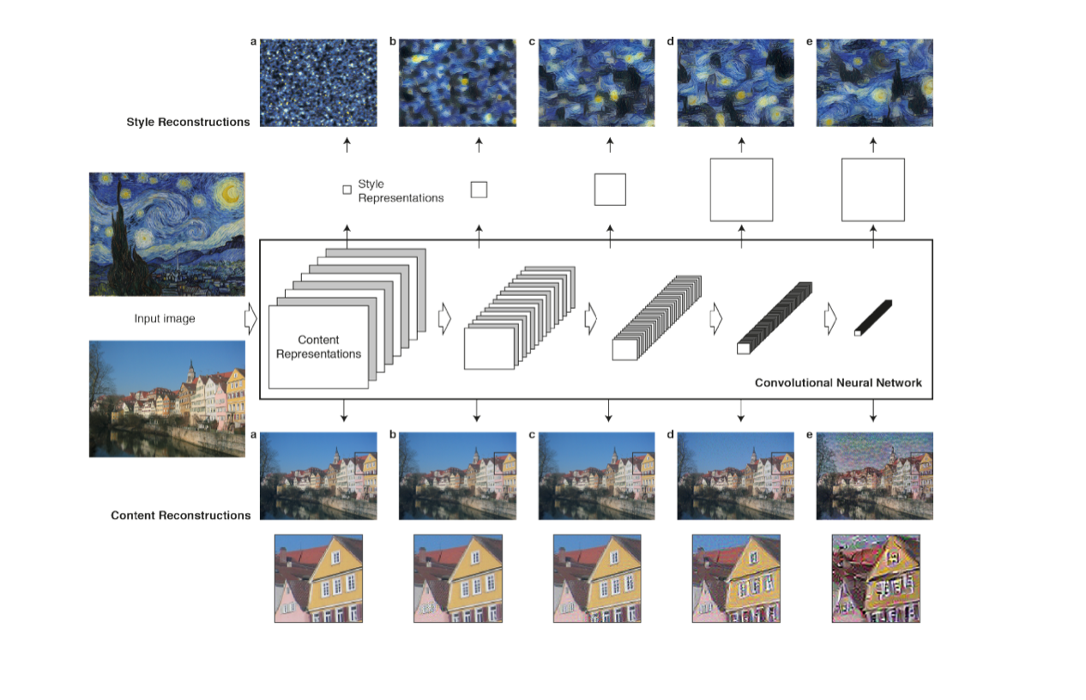
Image + Style Reconstruction
A Neural Algorithm of Artistic Style , Gatys et al. 2015

Slide 9
Hands-on: Neural style transfer
with TensorFlow Hub

Slide 10
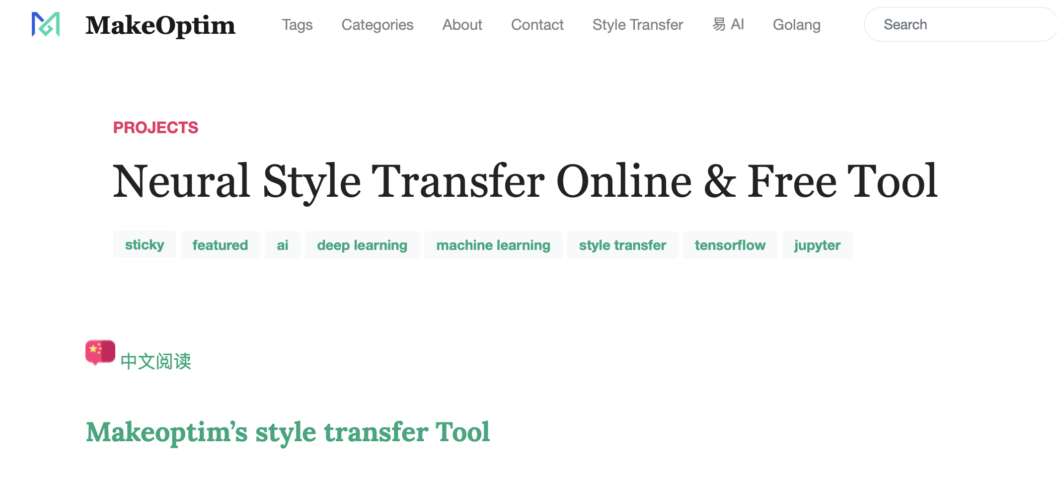
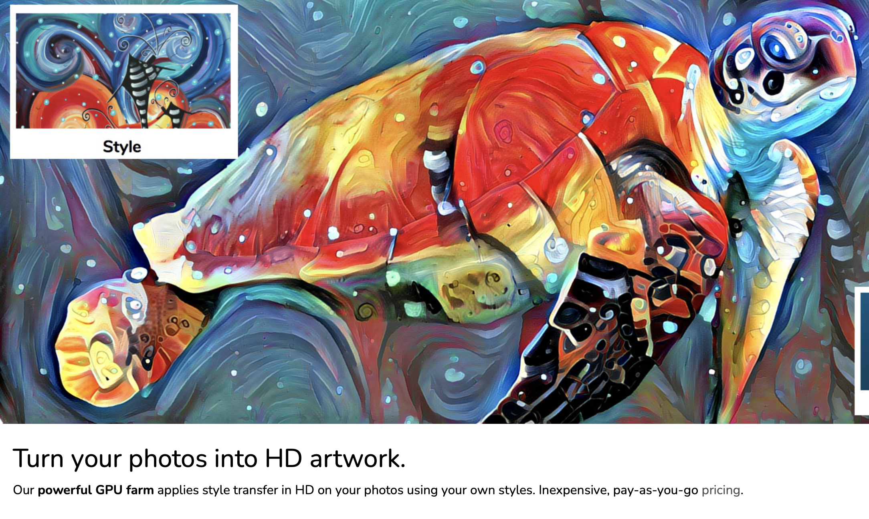
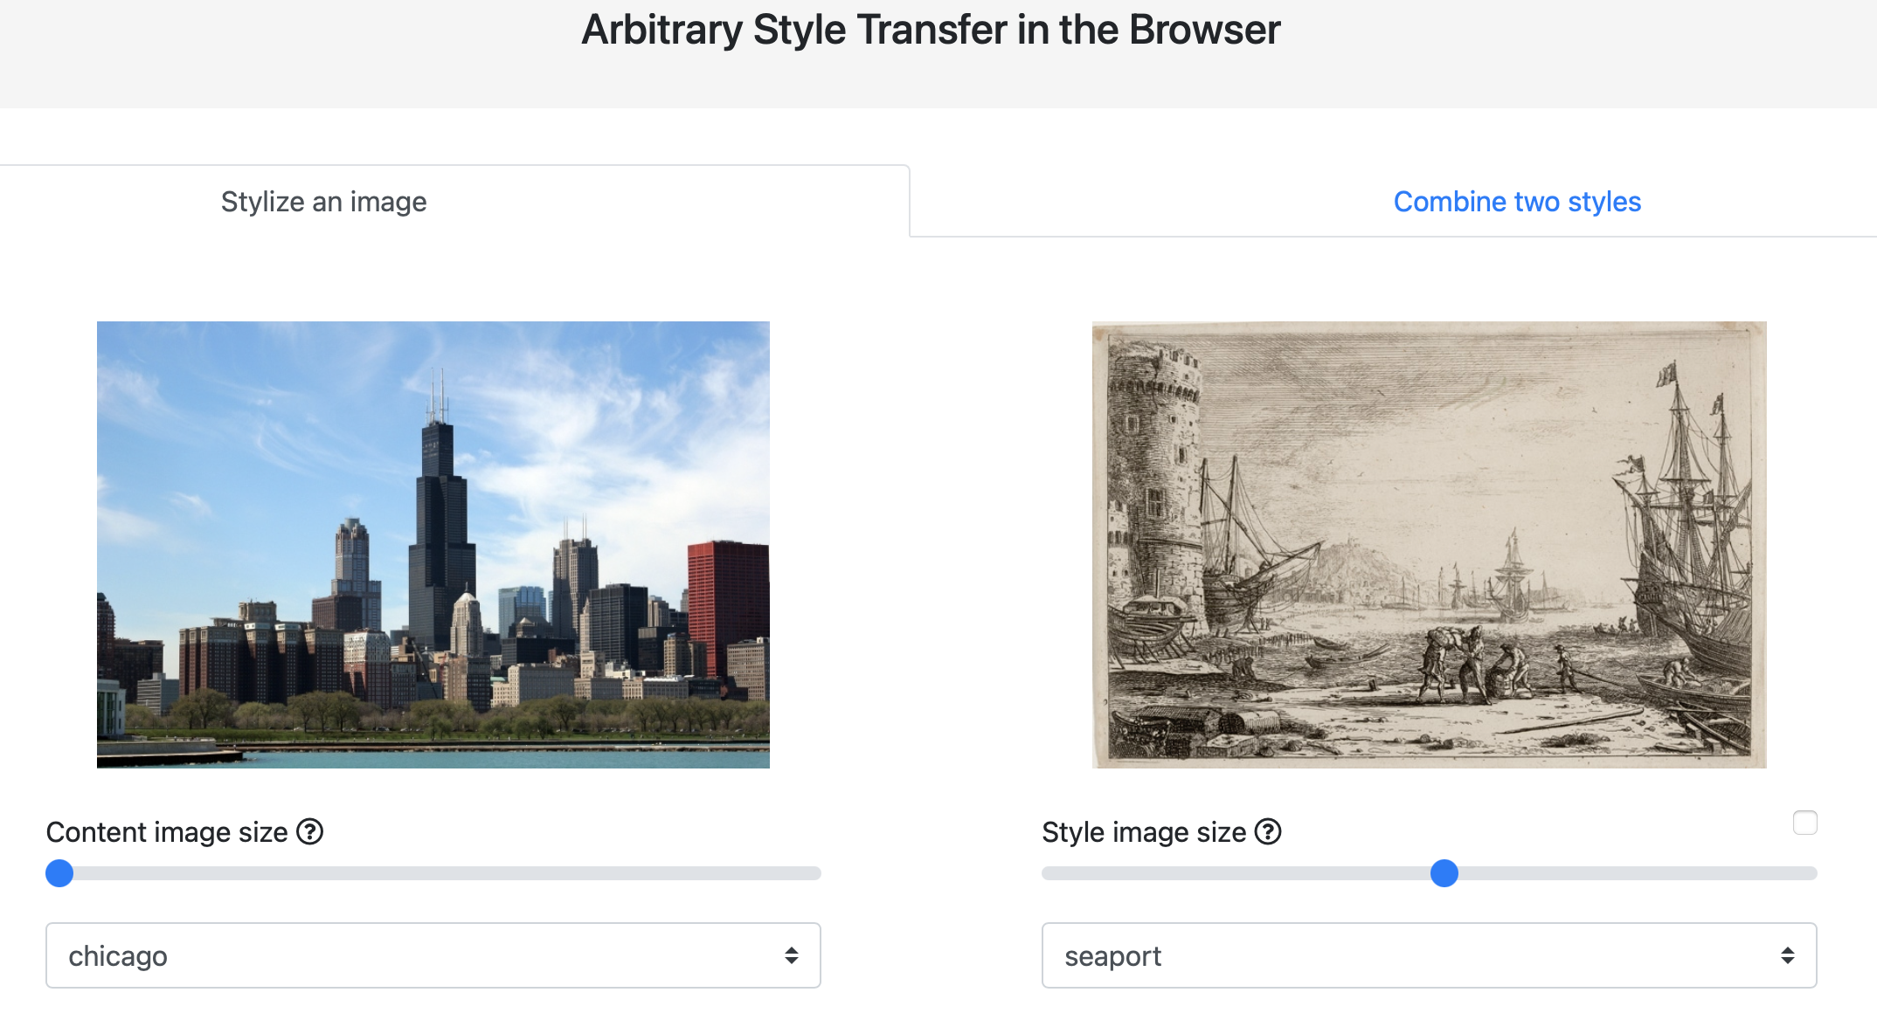

Style Transfer – Ready to use tools

